Slide 1
Hamilton County / National Grid Meeting
Reviewing Upcoming Project / Plans
Hamilton County
May 21, 2019

Slide 2
AGENDA
Introductions
Safety Moment
    Recognizing Something had to be Done
      Meetings held with County Leaders
Recently Completed and Future Projects
Short Term Reliability Work Plans
      Infrastructure Upgrades
  Longer Term Reliability Work Plans
      Potential Partnering Opportunity
  Vegetation Management
Next Steps

Slide 3

Safety
    Safety…Did it, done it, doing it tomorrow
    Watch your step - it could be your last tomorrow
    Work safe today–heaven can wait.
    Safety is a mission not an intermission
    Safety doesn’t happen by accident
    Those who work the safest way- live to see another day

Slide 4
Addressing the Reliability Concern
Addressing the Reliability Concerns
NG & Hamilton County officials met to discuss Reliability Issues
  Issues:
    Long duration outages which also impact Frontier Communications
    3 sub-transmission lines that feed County with no ties
    Lines located in heavily wooded & hilly terrain areas
    Not all critical customers identified
    NG communications needed to be improved during storms
  Next Steps:
    NG needs to develop workplan to improve reliability
    County asked to partner with NG on easement/ROW issues along with identifying danger tree situations
    NG to review Vegetation Management Cycles

Slide 5
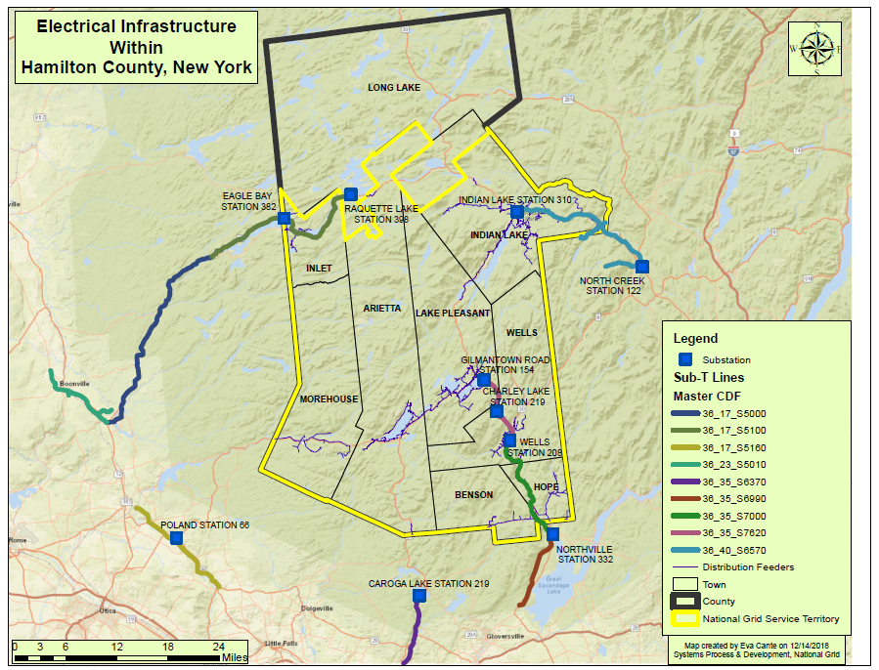
National Grid Electrical Infrastructure in Hamilton County

Slide 6
Actions and Happenings Since December & January Meetings
National Grid
    Communications / Contact improvements
    Critical Facilities List Updates
    Vegetation Management Review
    Engineering Assessment
    Automated ETR Analysis and Update
Hamilton County
    Critical Facilities List
    Frontier Cellular Communications
    Other

Slide 7
Recently Completed Projects in Hamilton County
(2014) Poland 62258 Route 8 Reconductor Phase I- Reconductored ~2.7 miles of primary wire
(2015) Northville-Wells #1, Wells-Gilmantown #2, 23kV Insulator Replacements - Replaced horizontal post insulators on ~65 sub-T structures (mobile generator was utilized to reduce outages during construction)
(2015) Replaced Indian Lake Station Transformer (preventative asset condition)
(2016) Wells-Gilmantown Rd #2, 23 kV Sectionalizer - Replaced sectionalizer with a line recloser
(2017) Gilmantown 51 - Upgraded recloser on pole 147 County Hwy 11
(2017) Gilmantown 51 - Upgraded defective regulator on pole 280 on State Hwy 8
(2017) Gilmantown 51 - Replaced recloser on pole 204h State Hwy 8
(2017) Boonville-Raquette Lake 46kV Line Improvements/Maintenance - Replaced ~24 structures and replace porcelain insulators with polymer
(2018) Gilmantown 51 - Pole 61 Piseco-Morehouse Rd - Replaced defective regulator

Slide 8
Short Term Reliability Work Plan – Sub Transmission
Old Forge – Raquette Lake #22
          National Grid installed temporary generation at 4 substations keeping customers energized during this 3 day late April blitz to refurbish the line.
          SCOPE: 40 crews; 2000 man hours
            69 structures – insulator replacements
            15 new pole installations
            Eagle Bay Recloser bypass repair
            Conductor Hot Spot repairs @ 2 locations
            Additional storm hardening work (guying, cross arms, reconductor, etc)
          BENEFITS: System hardening - insulator failures currently account for 29% of outages on the line; DOT projects; Broadband telecommunications

Slide 9
Short Term Reliability Work Plan – Sub Transmission
Northville – Wells #1
National Grid will complete a comprehensive insulator replacement project utilizing “hot stick” work methods which will allow the line to remain energized to supply customers
SCOPE: 436 horizontal line post insulators on 146 structures
BENEFIT: System hardening - insulator failures currently account for 38% of outages on this line.

Slide 10
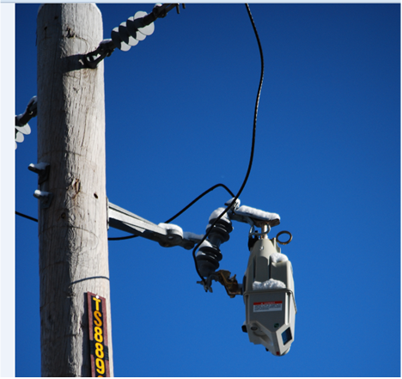
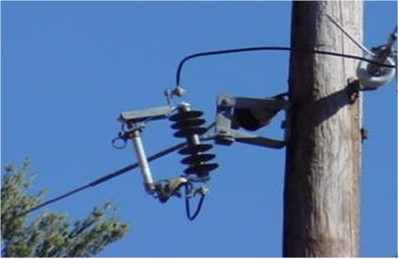
Short Term Reliability Work Plan – Distribution
A series of 17 projects representing 44 locations and approximately 650 man hours of work spread across every town in Hamilton County:
  Locations based on review of history and vulnerable feeder sections
  Includes additional protection for 14 critical customers
  Completion prior to Summer of 2019
    Reclosers and Trip Savers – These devices will attempt to reclose after an incident such as a tree blowing into the line and then clearing without breaking the line.
      New Reclosers – 3 locations (Indian Lake, Inlet, Mayfield)
      Trip Savers – 18 locations in 6 towns
    Fuses – This device is installed on single phase branches of a line to isolate a problem when it occurs and protect other customers served from the feeder
      New fuses 29; Refusing existing locations 28
Recloser
Trip Saver
Fuse

Slide 11
Longer Term Reliability Work Plan
National Grid is also working on longer term projects to continue to build a more resilient system in Hamilton County
    Upgrading high side protection at Gilmantown Station with 23kV recloser. This protection will replace fuses, which will reduce interruption duration for temporary conditions that would have otherwise blown those fuses. (ETA late 2019)
    Upgrade the station transformer at Charley Lake, which will provide more capacity, and regulators that will provide remote access capabilities for load readings (ETA late 2019)
    Line relocation opportunities to bring rear lot lines to the roadway in Wells. This will reduce the risk of outages and provide better access for crews to reduce interruption duration when they do occur. (ETA 2019 thru 2020) *PARTNERSHIP OPPORTUNITY*
    UG Cable replacements in Raquette Lake. Failures on this cable are typically long duration outages, due to the nature of underground repair process which includes locating the underground fault, excavating and then making the repairs (ETA 2019 thru 2021).
    Internal distribution feeder tie in Lake Pleasant, which will provide additional switching benefits to restore customers quickly while longer repairs are being made (ETA 2021)
    Continue phases III and IV of reconductoring and hardening the distribution feed on NY-8. This will harden the system with new poles and tree wire conductor, making it less susceptible to outages (ETA 2022-2023)

Slide 12
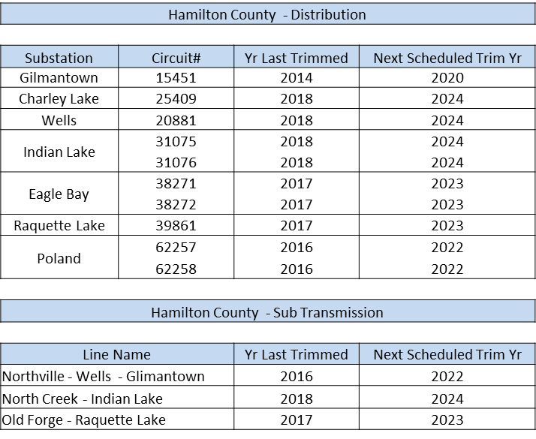
Vegetation Management Review
Distribution and Sub-transmission is on a 6 Year Cycle
    Cycle lengths are designed on pre-dominant species & growth patterns
      Hamilton County Hardness Zone – 3 & 4
      Slowest growth patterns in NY
    Primary impact to reliability is not growth but maturity and danger trees

Slide 13
Reliability Improvement Plan – Vegetation Management
Sub-transmission
Northville - Wells - Gilmantown - Hazard tree review and mitigation – completed March 2019
Old Forge – Raquette Lake - Hazard tree review and mitigation – completed December 2019
Accelerating Northville – Wells – Gilmantown trim cycle from 2022 to 2020
Distribution
Eagle Bay - Hazard tree review – start June 2019 (review and notification) – completed December 2019
Raquette Lake - Hazard tree review – start June 2019 (review and notification) – completed December 2019
Gilmantown - Hazard tree review – completed March 2019
Longer Term Opportunities
Forestport, Old Forge, Eagle Bay, Inlet, Raquette Lake

Slide 14
Additional Potential Opportunities
    National Grid is pursuing utility scale Non Wires Alternative solutions
    NYSERDA has grant money available through the NY Green Bank division for commercial customers looking to install battery storage projects.
      https://portal.greenbank.ny.gov/CORE_Solicitation_Detail_Page?SolicitationId=a0rt0000000QnyNAAS

